Slide 1
CS414 Rollerball - Project 3
Team Name : String Cheese
Members : Chris Schaffer, Meetkumar Savaliya,
Tim Stroup, Wei Chen , Ya-Hsin Cheng

Slide 2
Glossary Update
Board | The board is the combination of spaces that a piece may move and the boundaries of the game.
Game | A game consists of two users who take turns moving their pieces around the board.
GameHistory | Each game has an associated history that includes information on things such as which color a user was, end result and time played. Game history is the combination of all of these games.
GameState | The game state is a real time snapshot of a game that includes the current position of pieces on the board as well as who's turn it is.
Invitation | A user may send an invitation to another user as well as receive an invitation from another user to play a game. A user may send multiple invitations to multiple users to play a game.
Leaderboard | A scoreboard showing the names of users and their current scores. The system has one leaderboard that each user can view.
Piece | The game is played with different pieces; each with unique movements and rules. Each player has either six white or six black pieces that include two pawns, one king, one bishop and two rooks.
User | A person registered to play the game. They may send invitations to other users to play one or more games at a time. Each user has a user profile.
UserProfile | Visual display of personal data associated with a specific user such as name and games in progress. Each user profile can view their individual game history, and others’ profiles.
Terms sorted in alphabetical order.
Leaderboard:
The game -> The system.
UserProfile:
Each user can see others
gamehistory from the user
profile

Slide 3
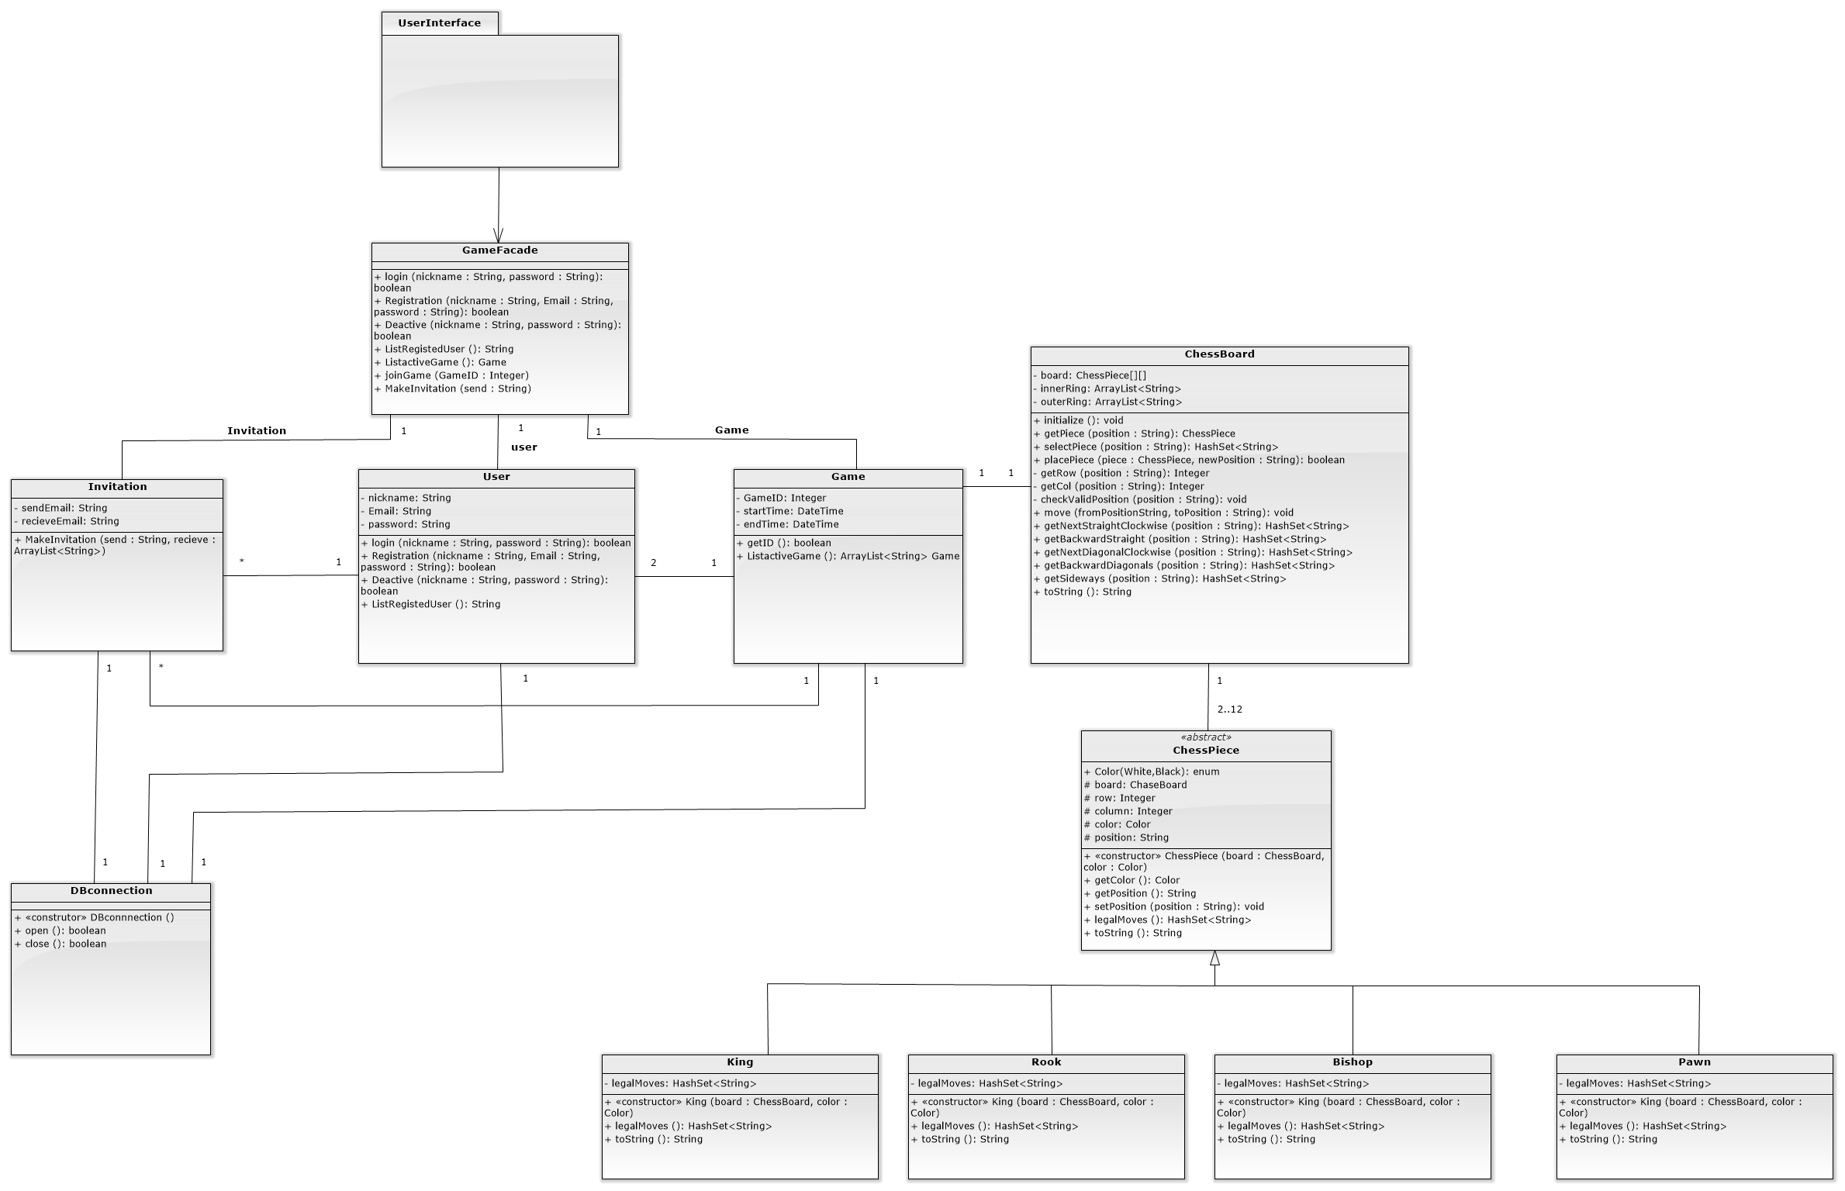
Class Diagram

Slide 4
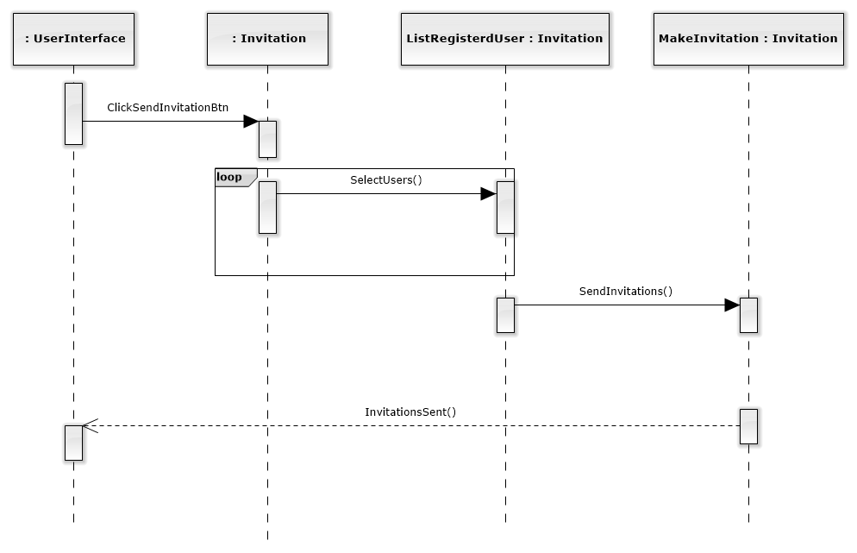
Sequence Diagram – Send Invitation

Slide 5
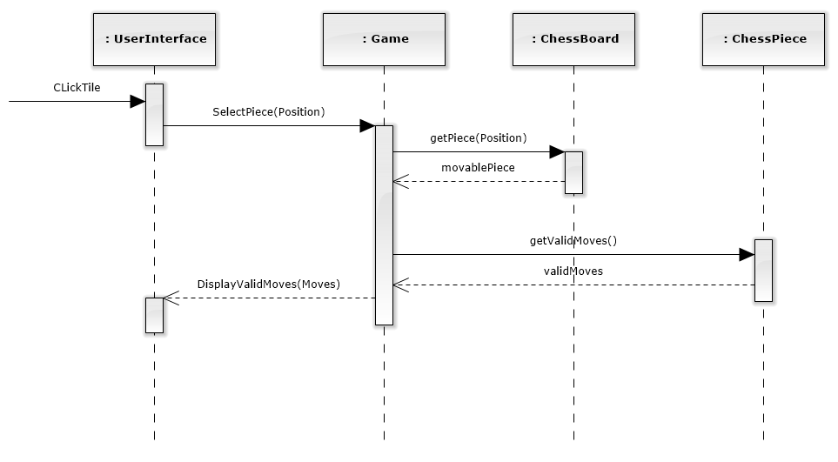
Sequence Diagram – Take Turn

Slide 6
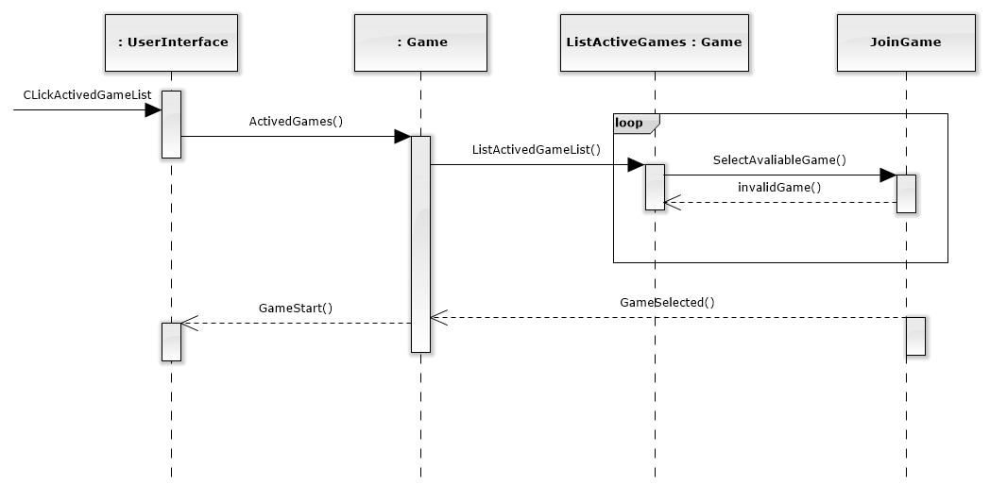
Sequence Diagram – Join Game

Slide 7
Traceability link matrix
 | ChessBoard | ChessPiece | Game | Invitation | User | DBconnection
UC1-Register Account |  |  |  |  | X | X
UC2-Create Game |  |  | X |  |  | X
UC3-Create Invitation |  |  |  | X |  | X
UC4-Deactivate account |  |  |  |  | X | X
UC5-Join Game |  |  | X |  | X | X
UC6-View Profile |  |  |  |  | X | X
UC7-Log on |  |  |  |  | X | X
UC8-Quit game |  |  | X |  | X | X
UC9-List active games |  |  | X |  | X | X
UC10-Take Turn | X | X | X |  | X | X
UC11-Update Game State | X |  | X |  | X | X
UC12-Display Valid Moves | X | X | X |  | X | X

Slide 8
Technologies and Tools

Slide 9
Q&A

